Slide 1
Scene text detection and recognition
Drug name detection and recognition

Slide 2
OCR vs STDR
OCR: Optical Character Recognition
STDR: Scene Text detection and Recognition

Slide 3



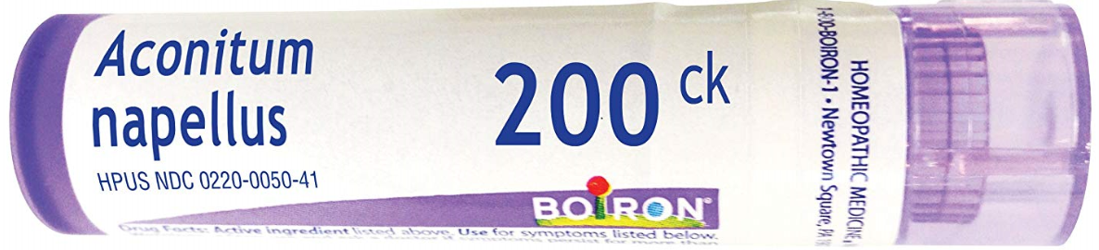
OCR vs STDR: Diversity of Text
Images from our Drug dataset
OCR STDR
Regular font different font
Single color multi-color
Consistent size multi-scales
Uniform arrangement different orientation

Slide 4

OCR vs STDR: Complexity of background
OCR STDR
White background
Or consistent background
Which can be converted
To white
Images from our
Drug dataset
Complex background
With elements like signs, fences are virtually undistinguishable from true text

Slide 5


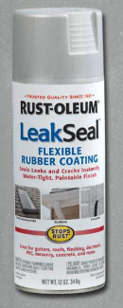

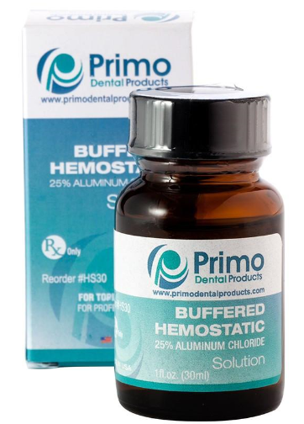
OCR vs STDR: Interference factors
OCR STDR
No
Interference
factors
Noise
Distortion
Low resolution
Non-uniform Illumination
Partial occlusion
Images from our drug dataset

Slide 6
OCR vs STDR: Performance
OCR STDR
99% accuracy
On scanned
document
Low detection rate: less than 80%
Low recognition rate: less than 60%
Ample room for research exist

Slide 7
Methods of Scene Text detection and Recognition
Text detection
Text Recognition
End-to-end text recognition

Slide 8
Scene Text detection- Methods
Property
Local intensities
Filter responses
Wavelet coefficients
cons
Computationally expensive
Sensitive to rotation
Sensitive to scale
Texture based
Methods for text detection
Steps
Extract component
Filter out non-text component
pros
Computationally efficient
Insensitive to rotation
Insensitive to scale and font
Component based
Become Mainstream in STD

Slide 9
Scene text detection-Representative works
SWT(stroke width transform) by Epshtein 2010
MSER(maximally stable extremal regions) by Neumann 2011
Solve the mismatch problem of edge points in SWT
Identify text candidates and Separate characters connections
SFT(stroke future transform) by Huang 2013
MSER+CNN by Huang 2014
Achieves significantly enhanced performance over conventional methods

Slide 10
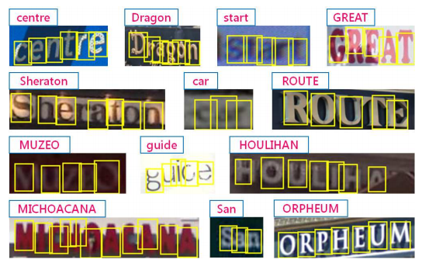
Scene Text recognition-Representative works
Strokelets by Yao in 2014
is the most novel representation
For text recognition

Slide 11
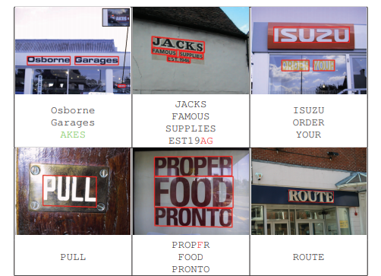
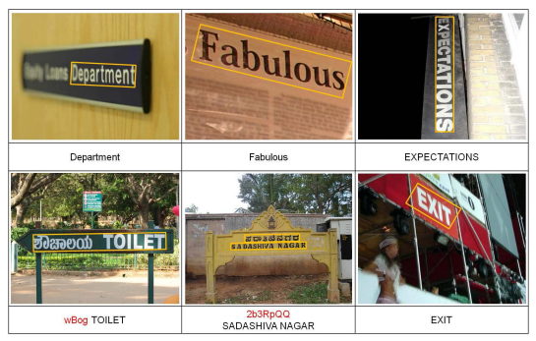
End-to-end Scene text recognition conventional methods
2012 publication “Real-Time Scene Text Localization and Recognition” by Neumann
Significantly improve accuracy but Only handle horizontal text
2012 “A unified framework for multi-oriented text detection and recognition” by Yao
First work that can read text of arbitrary orientations

Slide 12
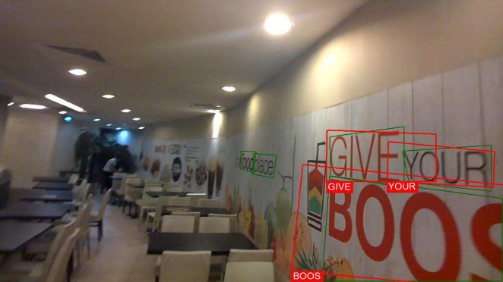
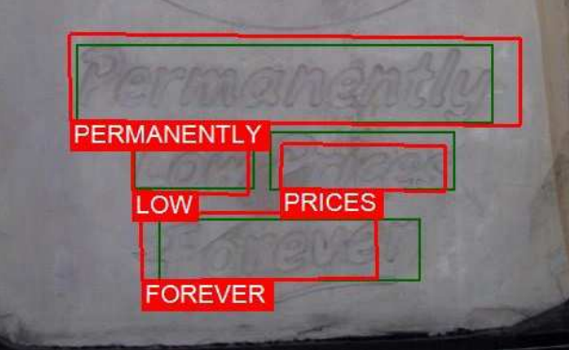
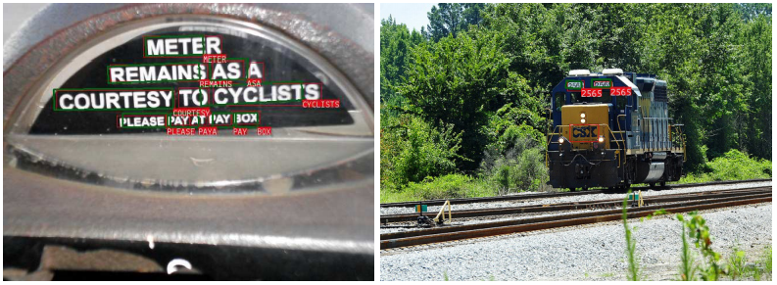
End-to-end Scene text recognition deep learning based methods
[2017-ICCV][STL][TR] Deep TextSpotter: An End-to-End Trainable Scene Text Localization and Recognition Framework

Slide 13
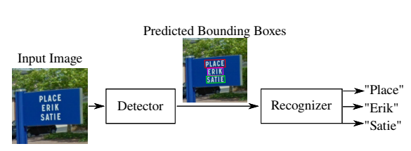
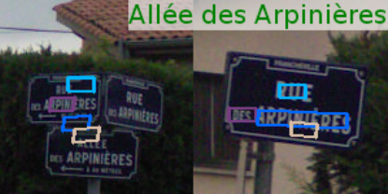
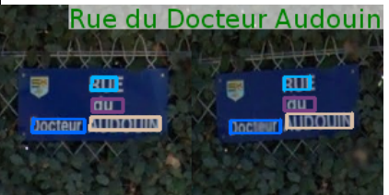
End-to-end Scene text recognition deep learning based methods
[2018-AAAI][STL][TR] SEE: Towards Semi-Supervised End-to-End Scene Text Recognition

Slide 14
End-to-end Scene text recognition Deep learning based methods-part 1
[2018-AAAI][STL][TR] SEE: Towards Semi-Supervised End-to-End Scene Text Recognition paper code
[2018-TIP][STL] TextBoxes++: A Single-Shot Oriented Scene Text Detector paper code
[2017-CVPR][STL] EAST: An Efficient and Accurate Scene Text Detector paper code
[2017-ICCV][STL][TR] Deep TextSpotter: An End-to-End Trainable Scene Text Localization and Recognition Framework peper code
[2017-ICCV][STL] Single Shot Text Detector with Regional Attention paper code
[2017-AAAI][STL] TextBoxes: A Fast TextDetector with a Single Deep Neural Network paper code
[2016-IJCV][STL][TR] Reading Text in the Wild with Convolutional Neural Networks paper demo homepage
[2016-ECCV][STL] CTPN: Detecting Text in Natural Image with Connectionist Text Proposal Network paper code
[2016-CVPR][STL] Synthetic Data for Text Localisation in Natural Images paper code data
[2016-arXiv][STL] TextProposals: a Text-specific Selective Search Algorithm for Word Spotting in the Wild paper code

Slide 15
End-to-end Scene text recognition Deep learning based methods-part2
[2015-PhD Thesis][STL] Deep Learning for Text Spotting paper code
[2015-TPAMI][TR] An End-to-End Trainable Neural Network for Image-based Sequence Recognition and Its Application to Scene Text Recognition paper code code
[2015-ICDAR][STL] Object Proposals for Text Extraction in the Wild paper code
[2015-ICCV][STL] FASText: Efficient unconstrained scene text detector paper code
[2014-NIPS][TR] Synthetic Data and Artificial Neural Networks for Natural Scene Text Recognition paper homepagemodel
[2014-ECCV][STL] Deep Features for Text Spotting paper code model GitXiv
[2014-TPAMI][TR] Word Spotting and Recognition with Embedded Attributes paper homepage code
[2012-ICPR][TR] End-to-End Text Recognition with Convolutional Neural Networks paper code SVHN Dataset
[2012-CVPR][STL][TR] Real-time scene text localization and recognition paper code
[2012-ICPR][TR] End-to-End Text Recognition with CNN paper code

